Slide 1
Week15_Lec2
Traffic shaping/Policing

Slide 2
Dimensioning best effort networks
approach: deploy enough link capacity so that congestion doesn’t occur, multimedia traffic flows without delay or loss
low complexity of network mechanisms (use current “best effort” network)
high bandwidth costs
challenges:
network dimensioning: how much bandwidth is “enough?”
estimating network traffic demand: needed to determine how much bandwidth is “enough” (for that much traffic)

Slide 3

Providing multiple classes of service
thus far: making the best of best effort service
one-size fits all service model
alternative: multiple classes of service
partition traffic into classes
network treats different classes of traffic differently (analogy: VIP service versus regular service)
granularity: differential service among multiple classes, not among individual connections
ToS bits
0111

Slide 4
Principles for QOS guarantees (more)
what if applications misbehave (VoIP sends higher than declared rate)
policing: force source adherence to bandwidth allocations
marking, policing at network edge
Give priority to audio packets
If audio data > 1.5Mbps, what will happen to HTTP?
Principle 1
provide protection (isolation) for one class from others

Slide 5
Principles for QOS guarantees (more)
allocating fixed (non-sharable) bandwidth to flow: inefficient use of bandwidth if flows doesn’t use its allocation
1 Mbps logical link
Principle 2
while providing isolation, it is desirable to use
resources as efficiently as possible

Slide 6
Scheduling and policing mechanisms
packet scheduling: choose next queued packet to send on outgoing link
previously covered in Chapter 4:
FCFS: first come first served
simply multi-class priority
round robin
weighted fair queueing (WFQ)
packet
arrivals
packet
departures
queue
(waiting area)
link
(server)

Slide 7
Policing mechanisms
goal: limit traffic to not exceed declared parameters
Three common-used criteria:
(long term) average rate: how many pkts can be sent per unit time (in the long run)
crucial question: what is the interval length: 100 packets per sec or 6000 packets per min have same average!
Latter 1000pkts/sec, former not possible
peak rate: e.g., 6000 pkts per min (ppm) avg.; 1500 ppm peak rate
(max.) burst size: max number of pkts sent consecutively (with no intervening idle)
Policing is regulation of the rate at which a class/flow is allowed to inject packets into network

Slide 8
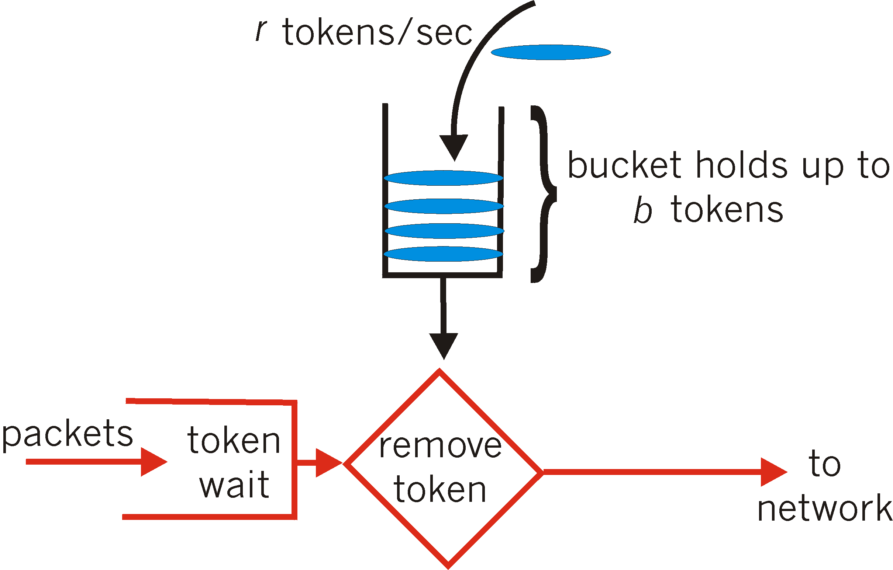
Policing mechanisms: implementation
token bucket: limit input to specified burst size and average rate
bucket can hold b tokens
tokens generated at rate r token/sec unless bucket full
over interval of length t: number of packets admitted less than or equal to (r t + b)

Slide 9
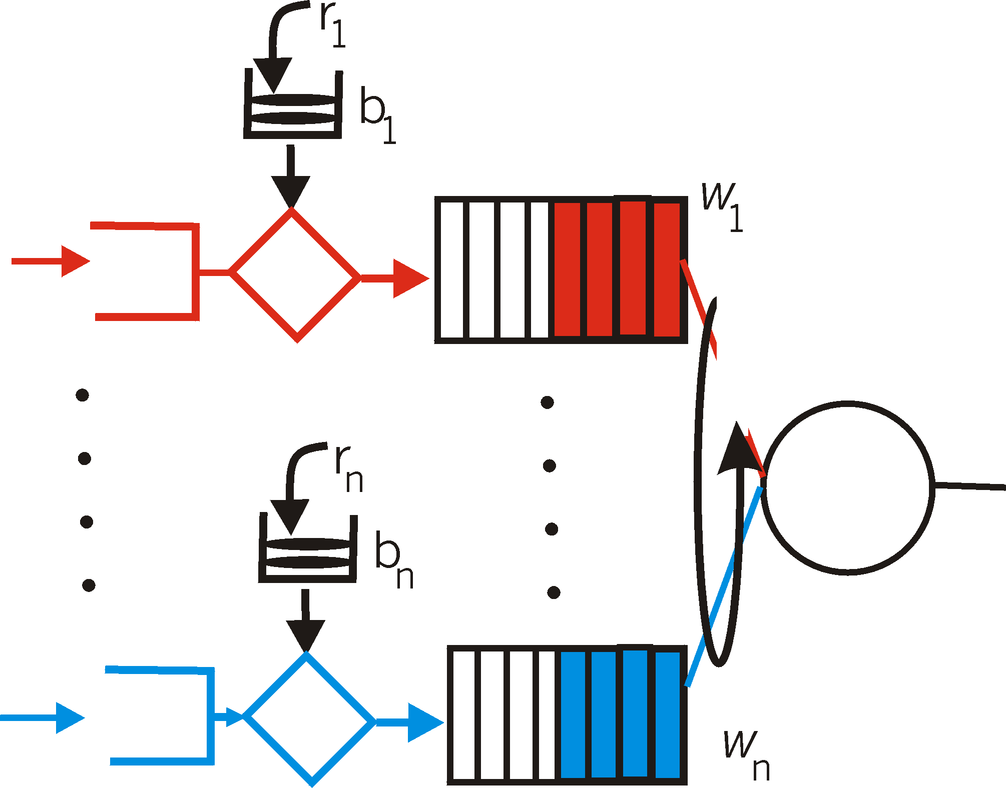
Policing and QoS guarantees
token bucket, WFQ combine to provide guaranteed upper bound on delay, i.e., QoS guarantee!
arriving
traffic
token rate, r
bucket size, b
per-flow
rate, R
WFQ
arriving
traffic

Slide 10
Differentiated services
want “qualitative” service classes
“behaves like a wire”
relative service distinction: Platinum, Gold, Silver
scalability: simple functions in network core, relatively complex functions at edge routers (or hosts)

Slide 11

Diffserv architecture
marking
r
b
scheduling
edge router:
per-flow traffic management
marks packets as in-profile and out-profile
.
.
.
core router:
per class traffic management
buffering and scheduling based on marking at edge
preference given to in-profile packets over out-of-profile packets

Slide 12
Diffserv packet marking: details
packet is marked in the Type of Service (TOS) in IPv4, and Traffic Class in IPv6
6 bits used for Differentiated Service Code Point (DSCP)
determine PHB that the packet will receive
2 bits currently unused
DSCP
unused

Slide 13
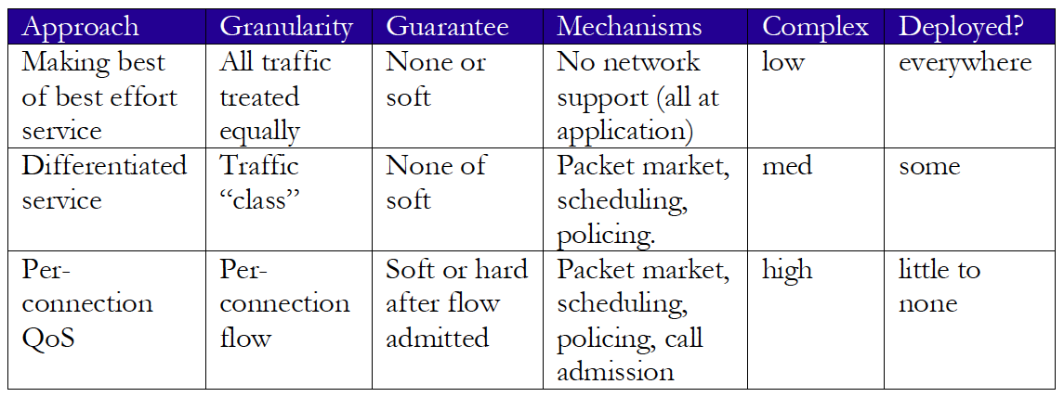
Network support for multimedia

